Slide 1
Basic Statistics

Slide 2

STATISTICS
Statistics is the science of data. It involves
Collecting,
Classifying,
Summarizing,
Analyzing,
And interpreting numerical information.
Statistics is used in several different disciplines (both scientific
and non-scientific) to make decisions and draw conclusions based on data.

Slide 3
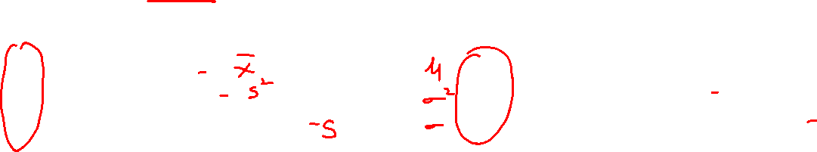
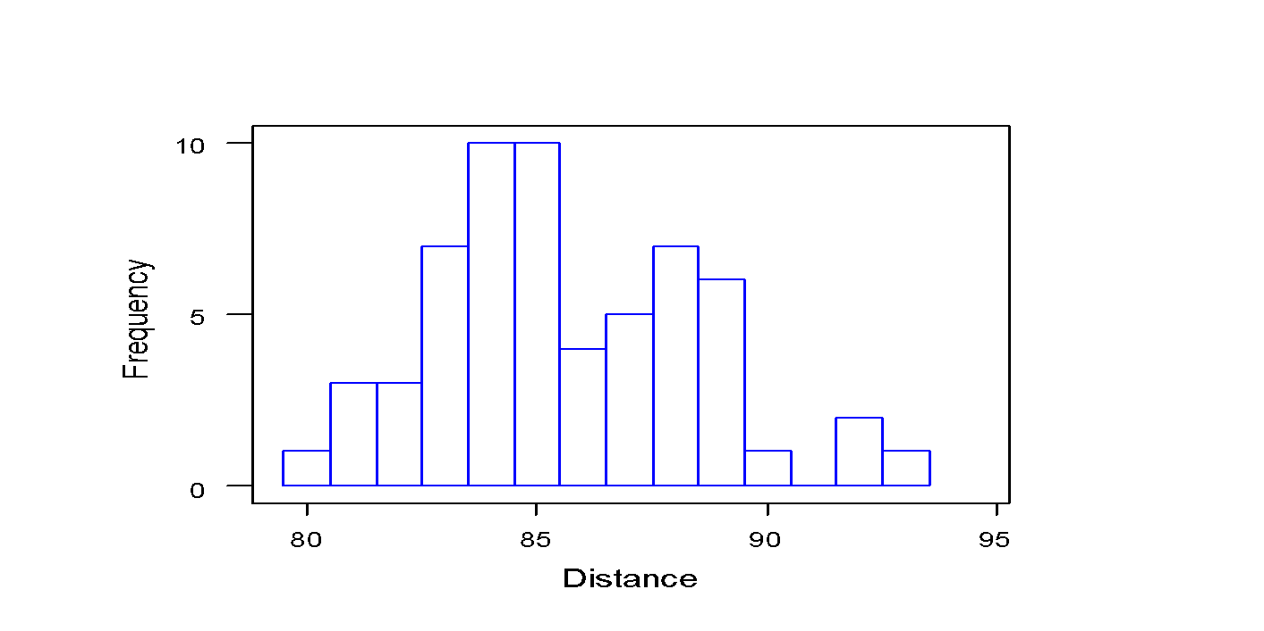
ENTIRE POPULATION
SAMPLE
SAMPLE
SAMPLE WITHIN
(subset)
POPULATION
Sample Statistics
A sample is a set of n observations actually
obtained and a statistic is a numerical value
that describes the sample.
X = Sample Mean
s² = Sample Variance
s = Sample Standard Deviation
Population Parameters
a hypothetical set of N observations from
which the sample is obtained (typically N
very large)
m = Population mean
s² = Population Variance
s = Population Standard Deviation

Slide 4
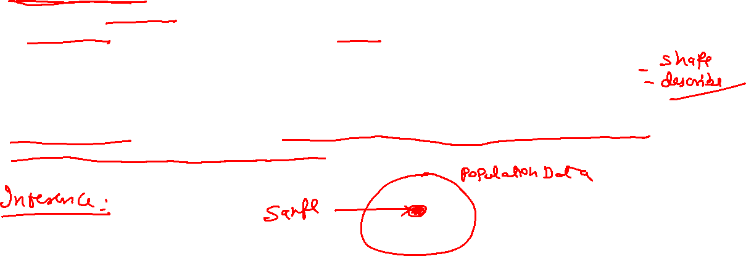
STATISTICS
There are two types of statistics that are often referred to when making a statistical decision or working on a statistical problem.
Descriptive Statistics : Descriptive statistics utilize numerical and graphical methods to look for patterns in a data set, to summarize the information revealed in a data set, and to present the information in a convenient form that individuals can use to make decisions. The main goal of descriptive statistics is to describe a data set. Thus, the class of descriptive statistics includes both numerical measures (e.g. the mean or the median) and graphical displays of data
(e.g. pie charts or bar graphs).
Inferential Statistics: Inferential statistics utilizes sample data to make estimates, decisions, predictions, or other generalizations about a larger set of data. Some examples of inferential statistics might be a z statistics or a t-statistics

Slide 5
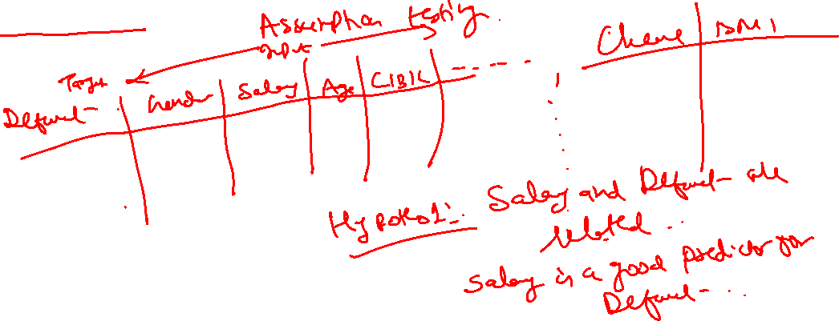
STATISTICS
Inferential Statistics:
The main goal of inferential statistics is to make a conclusion about a population based off of a sample of data from that population. One of the most commonly used inferential techniques is hypothesis testing
Ex: New drug tests

Slide 6
Descriptive Statistics

Slide 7
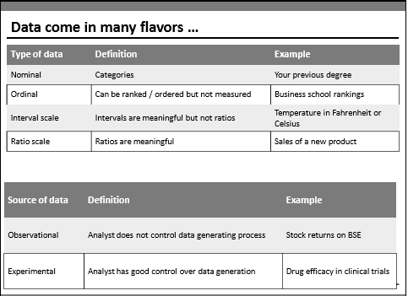
Data Types
Notes:
Here’s the problem with interval scales: they don’t have a “true zero.” For example, there is no such thing as “no temperature.” Without a true zero, it is impossible to compute ratios. With interval data, we can add and subtract, but cannot multiply or divide. Confused? Ok, consider this: 10 degrees + 10 degrees = 20 degrees. No problem there. 20 degrees is not twice as hot as 10 degrees, however, because there is no such thing as “no temperature” when it comes to the Celsius scale.

Slide 8
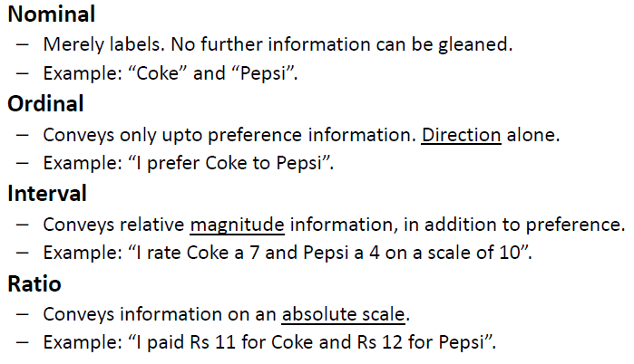
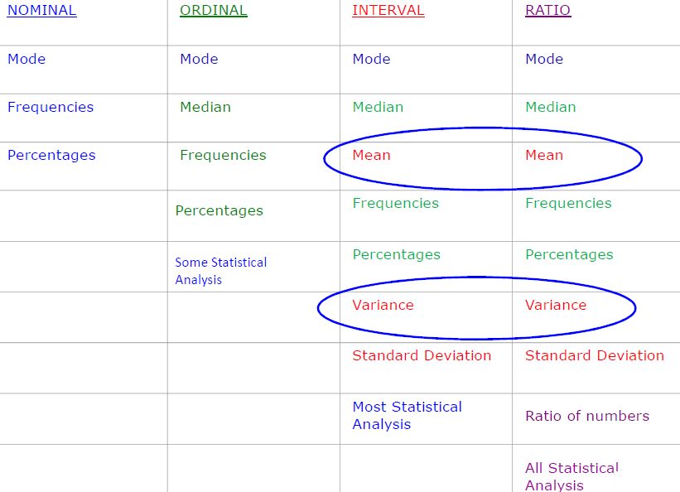
Data Types – Preliminaries
Notes:
Interval data always appears in the form of numbers or numerical values where the distance between the two points is standardized and equal.
Interval data cannot be multiplied or divided, however, it can be added or subtracted

Slide 9
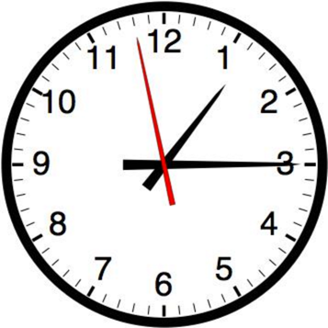

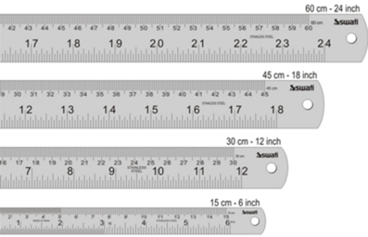



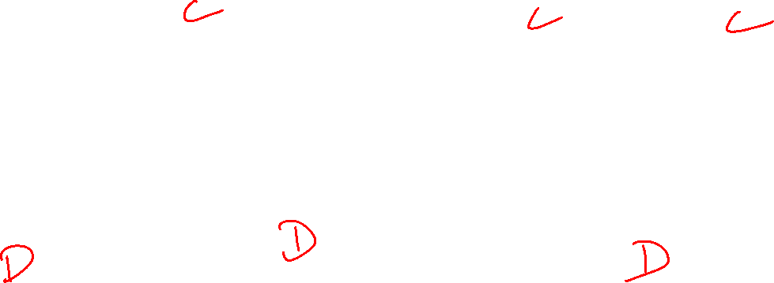
Data Types – Continuous & Discrete

Slide 10
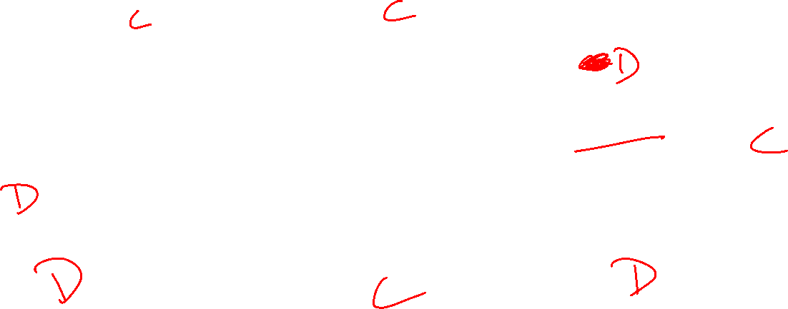
Group the following as either discrete or continuous data.
Speed of a car
Volume of a cereal box
Population of a town
Length of a crocodile
# Shirts
Discrete? Continuous?
Number of goals in a season
Temperature of oven
Number of matches in a box

Slide 11





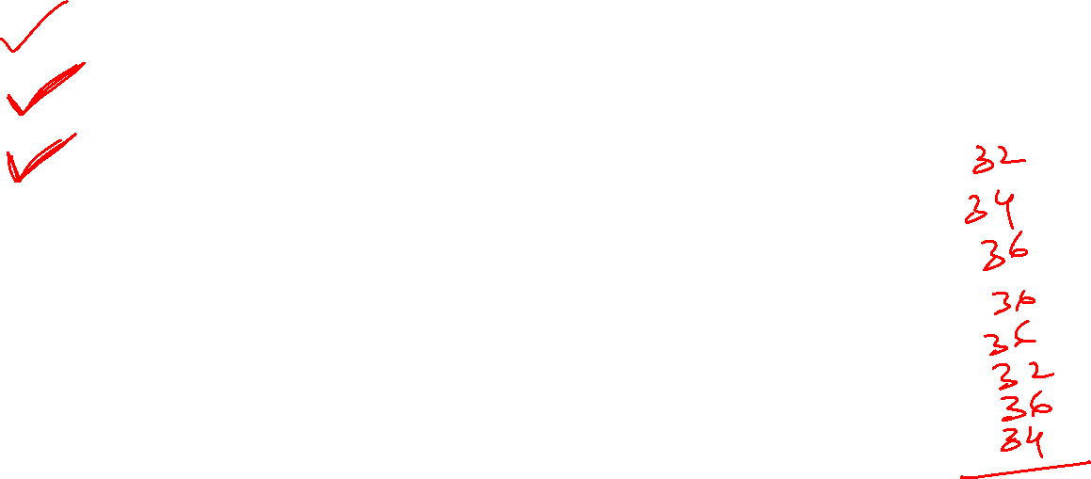
Measures of Central Tendency
Central Tendency | Population | Sample
Mean / Average
Median | Middle value of the data
Mode | Most occurring value in the data
“Every American should have above average income, and my Administration is going to see they get it.” – American President

Slide 12
Sample Mean for a Distribution
For a discrete function
S y means, “Add up all the Y's”
_
^
N
μ = Σ x_{i} /N
= X₁ + X₂ +....X_{N}
N
X=
i=1
Examples:
Coating weights: 8.47, 8.67, 9.34, 7.99
Coating AVERAGE = 8.47 +8.67 + 9.34 + 7.99 = 8.62
4
Batting Performance: 0, 0, 1, 0, 1 (0= no hit, 1=hit)
BATTING AVERAGE = 0+ 0 +1 +0 + 1 = 0.400
5
Mean = Average

Slide 13
Sample Median
Assume that x1, x2, …xn is a list of sample data sorted in ascending order.
Then…
X =
~
middle value, if n is odd
the average of the two middle values, if n is even
{
Find the sample mean and median for the two data sets below:
X: Data Set 1 : 10, 12, 11, 14, 11, 13, 12, 14, 16, 13
X = X =
Y: Data Set 2: 10, 12, 11, 14, 11, 13, 12, 14, 44, 13
Y = Y =
~
~

Slide 14
Mode
The modal value of a set of data is the most frequently occurring value.
Find the mode for: 2, 6, 3, 9, 5, 6, 2, 6
It can be seen that the most frequently occurring value is 6. (There are 3 of these)
Bi model and Multi model
Mode for:
1,2,3,3,3,4,4,4,5,6,7
2,2,3,10,11,17,3,10

Slide 15
Measures of Variability
The mean, mode, and median do a nice job in telling where the center of the data set is, but often we are interested in more…
For example, a pharmaceutical engineer develops a new drug that regulates sugar in the blood.
Suppose she finds out that the average sugar content after taking the medication is the optimal level.
This does not mean that the drug is effective. There is a possibility that half of the patients have dangerously low sugar content while the other half has dangerously high content.
Instead of the drug being an effective regulator, it is a deadly poison.
What the pharmacist needs is a measure of how far the data is spread apart. This is what the variance and standard deviation do
Notes:
Normal blood sugar levels are less than 100 mg/dL after not eating (fasting) for at least eight hours. And they're less than 140 mg/dL two hours after eating.

Slide 16



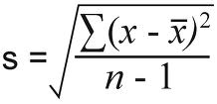
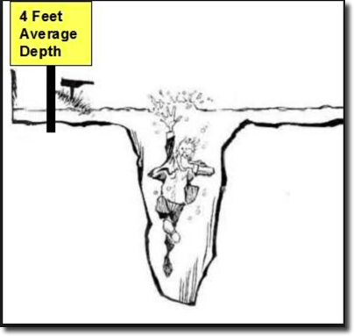
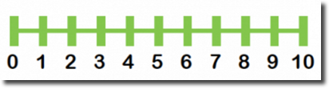
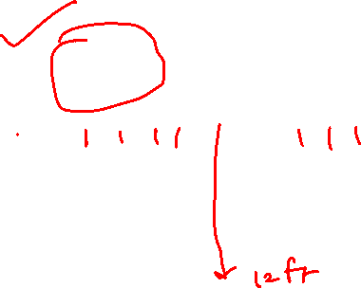
Measures of Dispersion
Dispersion | Population | Sample
Variance
Standard Deviation
Range | Max – Min

Slide 17
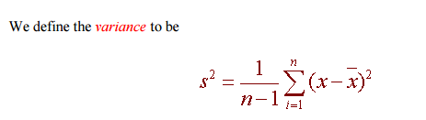
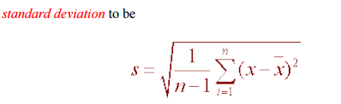

Slide 18
Computing step by step
Variance and Standard Deviation: Step by Step
Calculate the mean, x.
Write a table that subtracts the mean from each observed value.
Square each of the differences.
Add this column.
Divide by n -1 where n is the number of items in the sample This is the variance.
To get the standard deviation we take the square root of the variance.

Slide 19

Measures of Variability
Deviation is the distance from the mean.
Deviation score = observation - true mean
Variance = mean or average of squared deviation scores.
.
Standard Deviation = square root of variance.
μ
= Population Mean
♓
Deviation (distance from mean)

